Slide 1
Second Galicia?
Poland’s ‘fossil’ narratives in the longue durée
Roberto Cantoni, PhD – CERI, Sciences Po Paris
roberto.cantoni@sciencespo.fr
8th EOGAN Conference, TOTAL HQ, Paris, 2 June 2017

Slide 2

“Shale gas? Yes, we can!”
IEA’s World Energy Outlook 2011: Entering a ‘golden age of gas’
US shale revolution → Chances for European countries?
Poland: think tanks push gov’t to take action: new jobs, energy autonomy, ‘Russia’s nightmare’

Slide 3
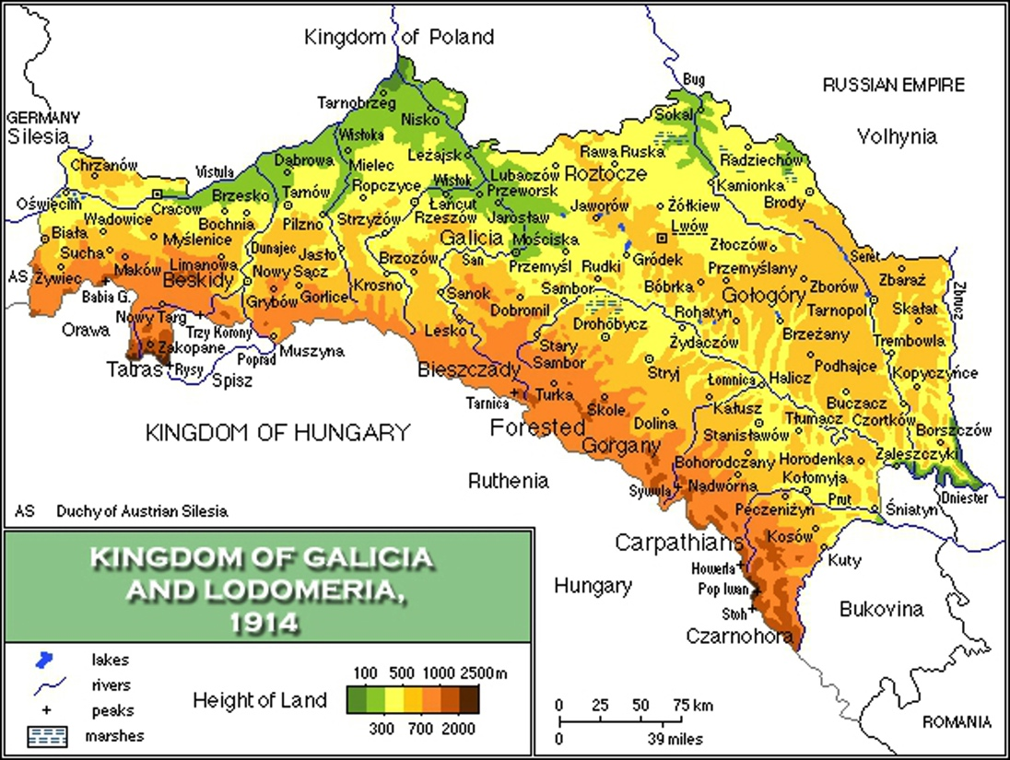
XIX c. Galician oil boom

Slide 4
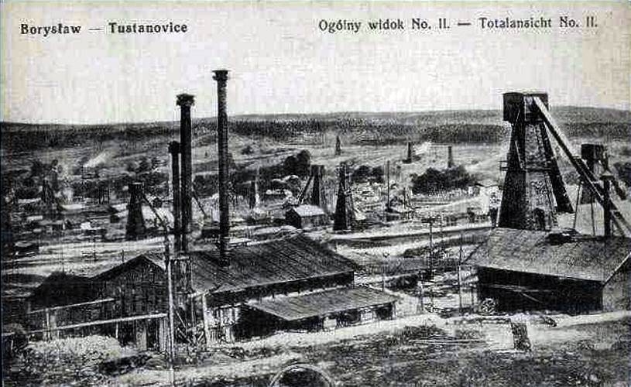
1835: about thirty surface oil mines operated in Borysław, Galicia
1854: oil found in Bóbrka well
1856 onwards: large-scale extraction starts in the region; construction of the first refineries

Slide 5
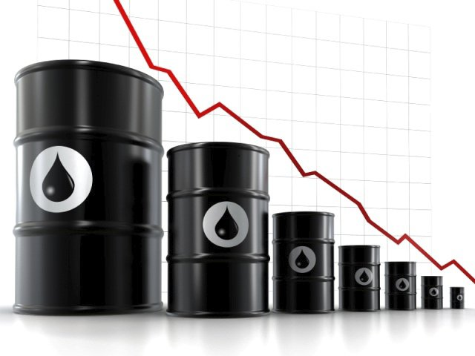
Decline and stagnation
Interwar period: production declines and then stagnates
1918: Territorial dispute with Ukraine for sovereignty over Galicia
By 1925 Galicia’s oil is gone, and even the few reservoirs are sold to the French for their support of Polish Republic

Slide 6
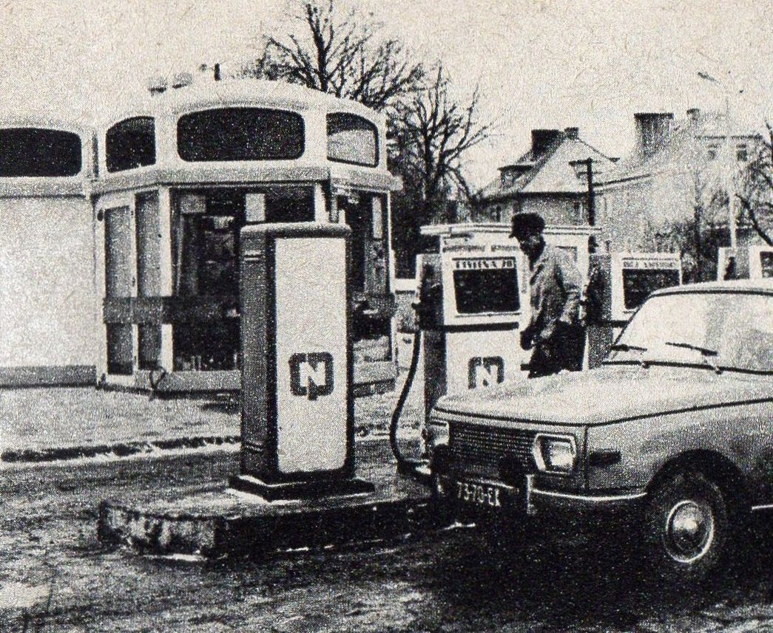
Soviet times and beyond
1944: Constitution of Polish Oil Monopoly, later Office for Petroleum Products
1959: Construction of Mazovia Refining Plant (in central Pol)
1961-5: first, small oil reservoirs found in the Polish Plain
1976: foundation of ZGNiG, later PGNiG
1990s: more oil discoveries; constitution of Polish Oil Concern (PKN), later PKN Orlen

Slide 7

Second Galicia?
Large prospecting effort, but deceptive outcomes, and old technology
Today, Poland depends massively on Russia for oil, gas, and even coal
Following the publication of early estimates on Poland’s shale gas, hype about a ‘new Norway’ or ‘second Galicia’
Fast political consensus reached on the need of exploration; “Poland has the means to do that”

Slide 8
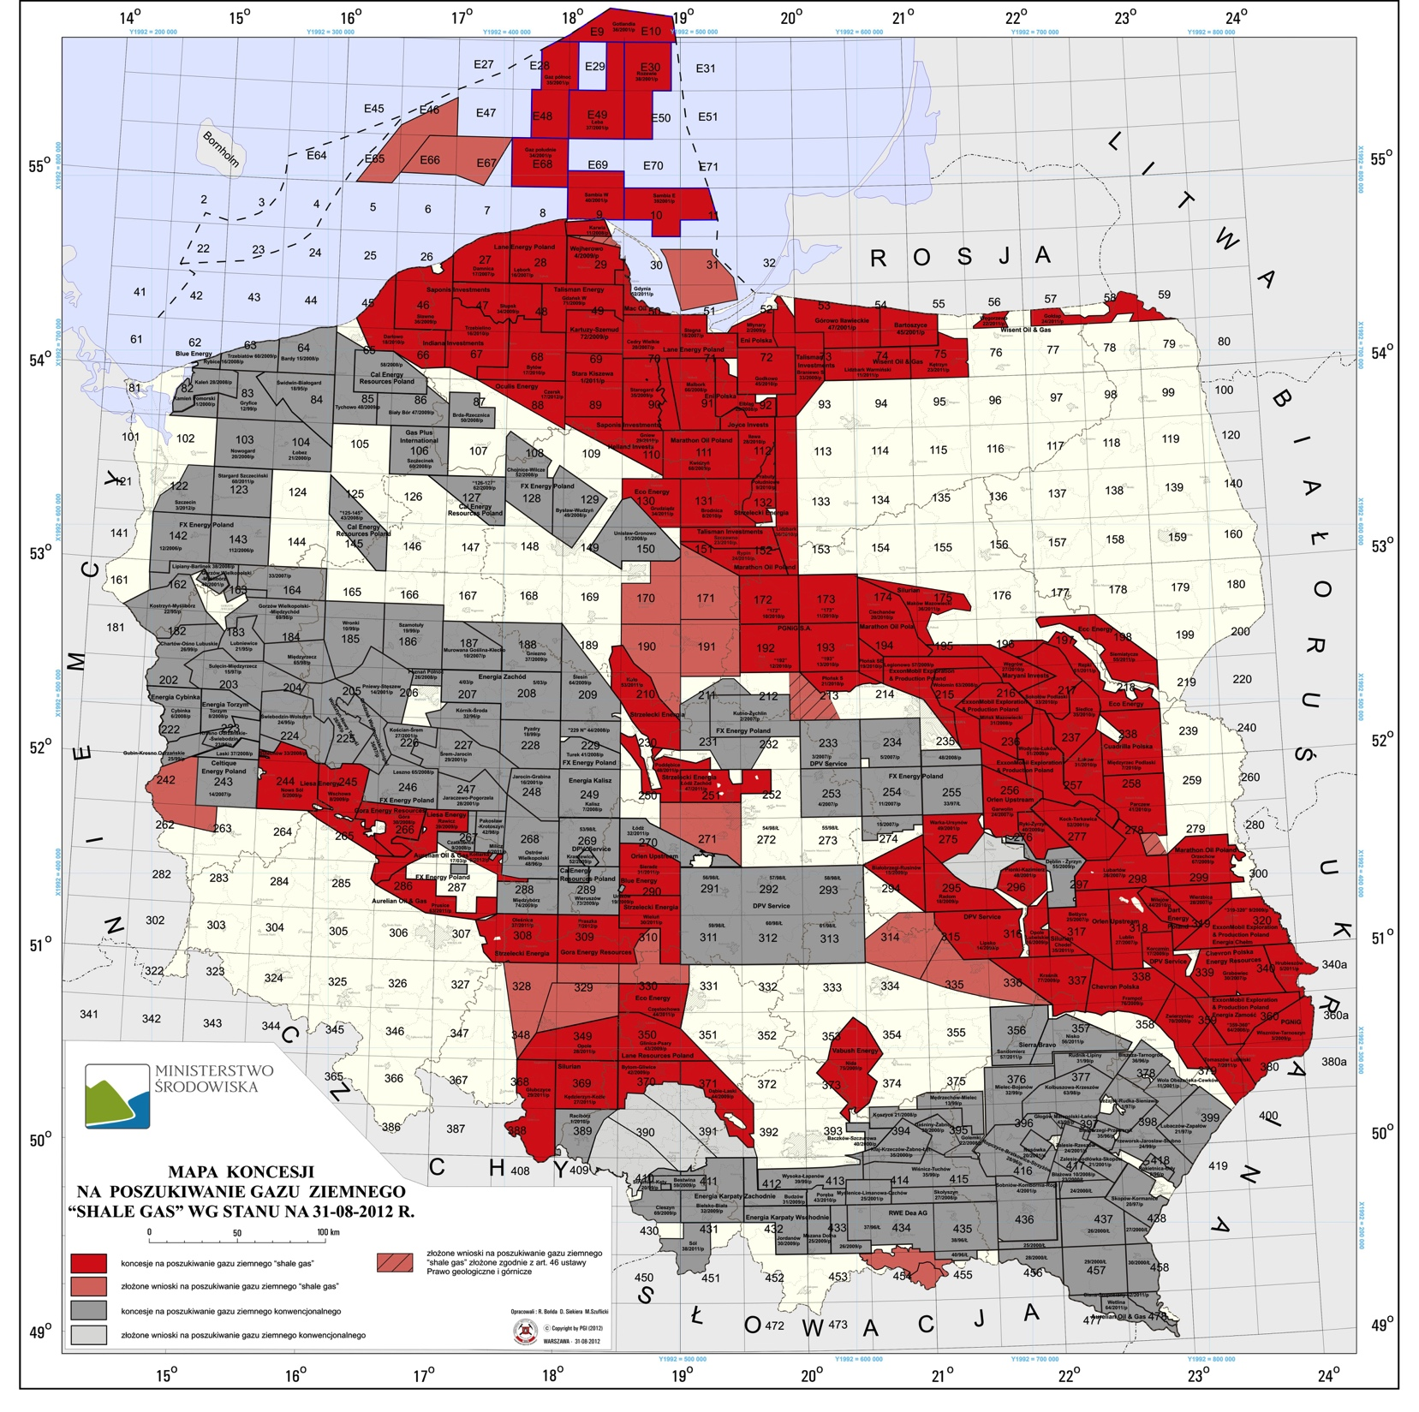
Overconfidence
Political factors: gov’t forced by opposition to take more protectionist stance
Legislation: Polish gov’t unready to formulate adequate legislation to regulate shale gas business in short time
Unexpected (?) technical problems: US fracking doesn’t work as it is → needs adaptation → needs investment → but...
Geoeconomics: drop in oil price makes investments unprofitable

Slide 9
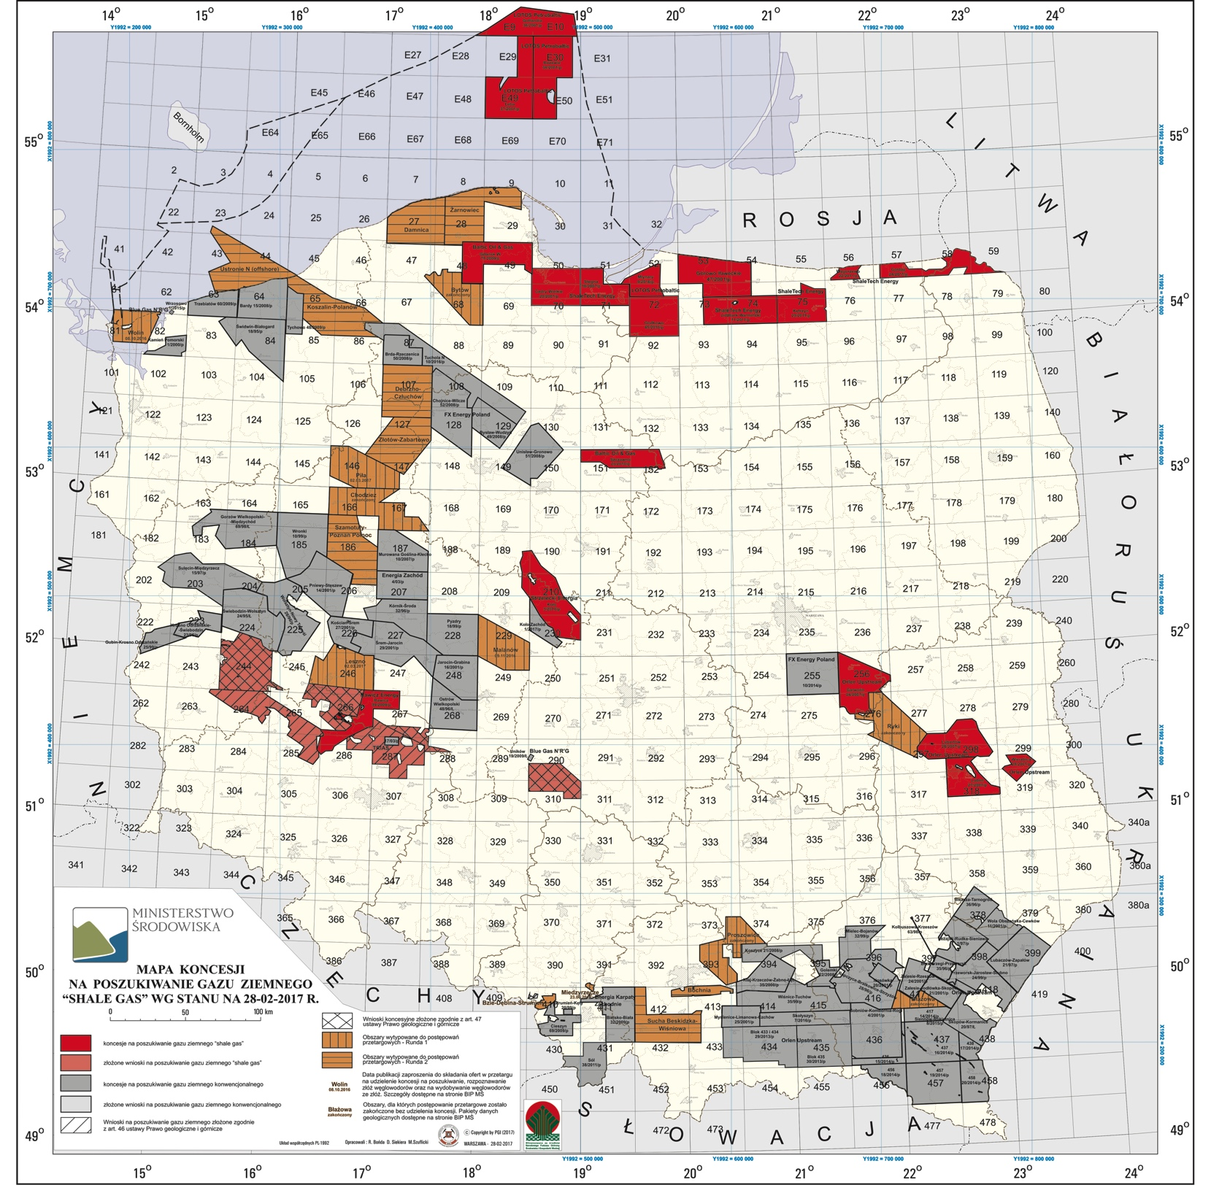
Overconfidence
Political factors: gov’t forced by opposition to take more protectionist stance
Legislation: Polish gov’t unready to formulate adequate legislation to regulate shale gas business in short time
Unexpected (?) technical problems: US fracking doesn’t work as it is → needs adaptation → needs investment → but...
Geoeconomics: drop in oil price makes investments unprofitable

Slide 10
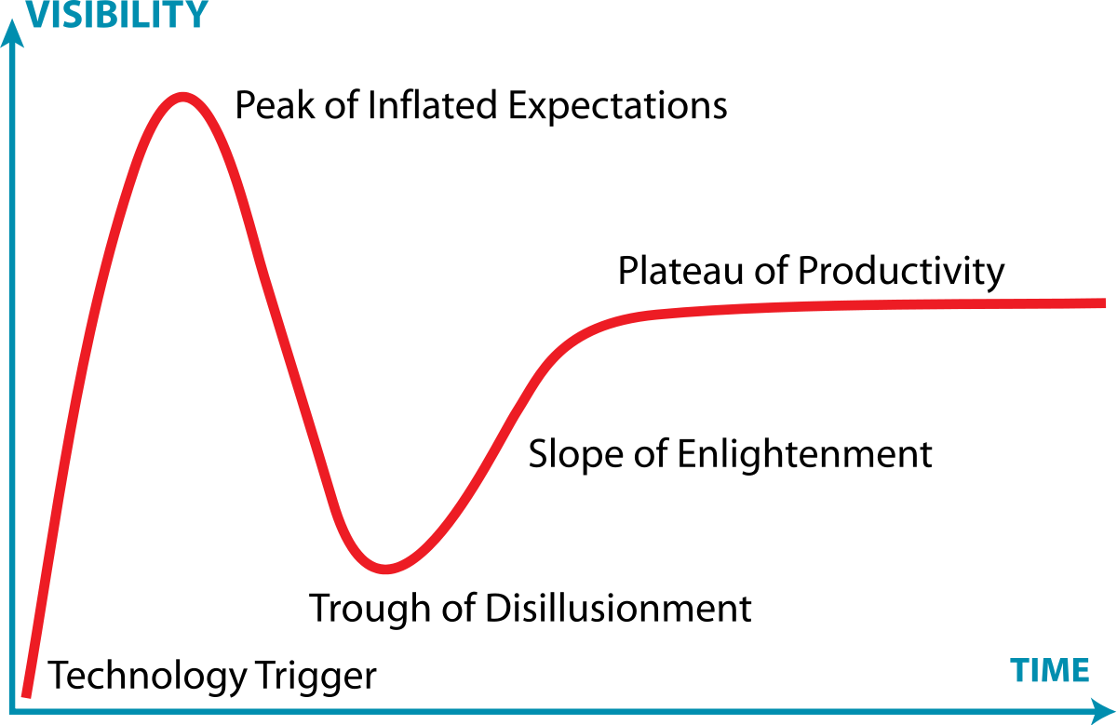
Conclusions
Hype-hope-disillusionment cycle: is this a ‘natural’ path? Neglect of uncertainties (at least in public discourse)
Narrative of antiquity of Poland’s oil industry didn’t mean much when confronted with the lack of technological state-of-the-art know-how: experience with coal in XX c. or oil in XIX c. may not be particularly useful for shale gas in XXI c.
Gartner, 1990s and on

