Slide 1
The oil industry, energy security, and international development: the EEC and OPEC
Eogan 2017
Paris – Total Archives
Marta Musso

Slide 2
EEC & OPEC
post-colonial relations between European countries and former colonies
US Vs European companies in Europe
1973 peak of a process

Slide 3
Energy dependency EEC-9 source: Integrating Energy: the Problems of Developing an Energy Policy in the European Communities 1945-1980 Hassan, J A;Duncan, A Journal of European Economic History; Spring 1994; 23, 1

Slide 4
Energy dependency EEC-9 source: Paul Warde

Slide 5
Energy consumption EEC-9 source: BP statistics (2016)

Slide 6
Energy Institutions
1944/47 - European Coal Organization
1948 - OEEC -> permanent Committee on energy
1952 - the European Coal and Steel Community (ECSC)
1955 – Messina Intergovernmental working group -> Committee on Classic Energy

Slide 7
The Cartel
producer countries
cartel
consumer countries
Stability of supplies
Stability of prices
Self-financed
Middlemen with
producer countries

Slide 8
*outside USSR / USA
The Cartel (1920s-1950s)
Company | Turnover 1960 ($ bn) | % world prod.* | % world reserves
SONJ | 8.9 | 16.48 | 12
Shell | 5.9 | 8.92 | 8
BP | 1.5 | 26.39 | 15
Gulf | 2.8 | 17.71 | 13
Texaco | 2.7 | 10.03 | 7
Standard Cal. | 2.3 | 9.57 | 7
Standard NY | 2.6 | 5.86 | 8
TOTAL | 27.6 | 94.96% | 70%
CFP | 34bn olf francs | 5.04%

Slide 10
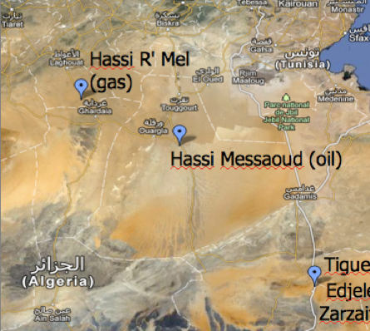
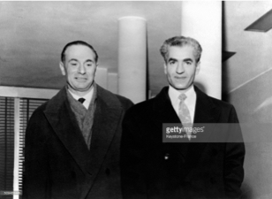
Politics of direct supplies
France
Italy
CFP + State bodies (UGP; BRP, etc)
Sahara
Import quotas on crude
Taxation on products
Ascoop
ENI (integrated company)
Joint-venture system & State-State negotiations
European consortium
Russia
Formula Mattei

Slide 11
1960s
North Africa new area of production (Algeria, Libya)
New operators (US indie, European, Japanese companies)
Russian oil
Opec not effective
EEC problems: prices too low (coal) + EUROPEAN companies

Slide 12
1970s
Feb 1971 Teheran agreement
Apr 1971 Tripoli agreement
Apr 1971 Algerian nationalisation
Aug 1971 end of gold exchange standard
1972 nationalisation waves
April 1973 Commission release
Aug 1973 “Oil Weapon” meeting
Oct 1973 OPEC +20% + production cuts
Oct 1973 OAPEC embargo (US, NE)

Slide 13
1973 crisis in Europe
No activation of oil sharing emergency plan
State-level intervention
No EC-level intervention
Bilateral agreements
NIEO V IEA

Slide 14
A tale of two conferences
Feb 1974: consumers’ conference in Washington (EAG)
Apr 1974: UN votes the NIEO
Nov 1974: IEA
Dec 1974: EC resolution on energy
Mar 1975: CIEC (Conference on International Economic Cooperation)

Slide 15
CONCLUSIONS
Big fracture between laissez-faire and State control (IT-FR V DE-NE)
Different approach to OPEC and producer countries in general (IT-FR V DE-NE)
1973/75 watershed moment (and victory of neoliberal approach)

Slide 16
An opportunity for EOGAN

