Slide 1
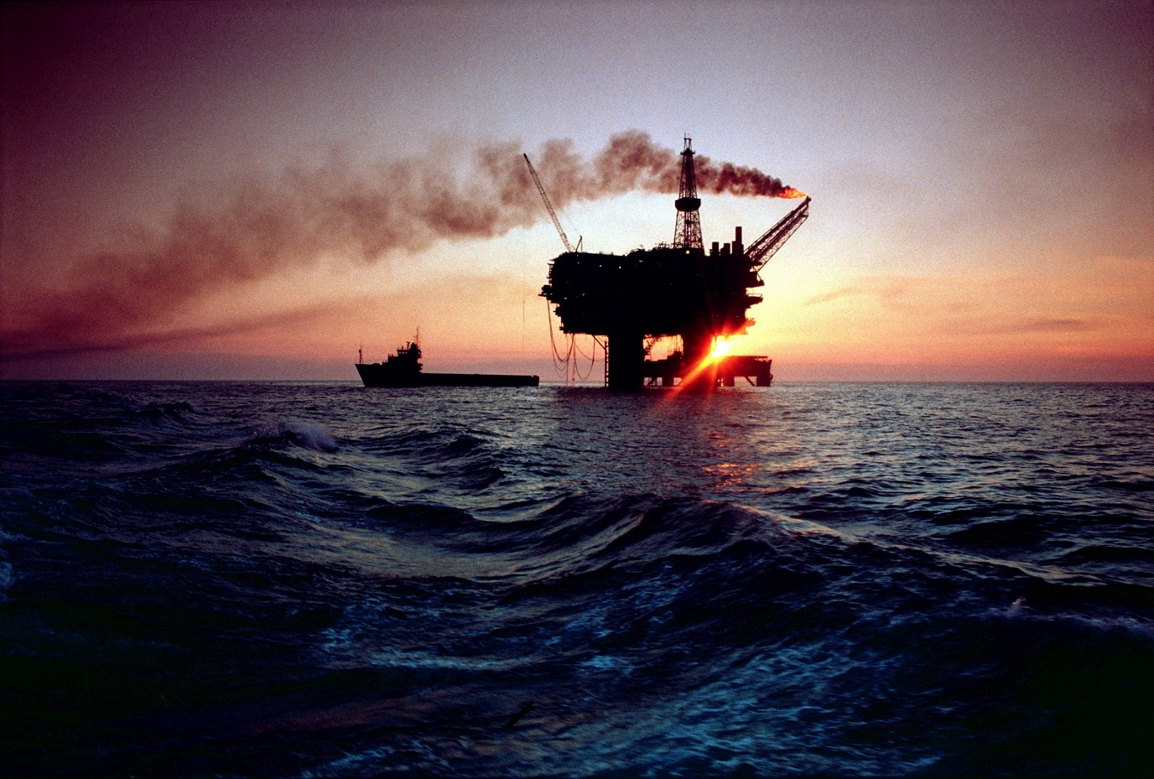
Image © Shell UK
Sunset on the North Sea?
Joe Chapman, ‘Capturing the Energy’,
University of Aberdeen
EOGAN Conference, Paris, 01-02 June 2017

Slide 2
Reports of North Sea oil’s death exaggerated?
Overview
Conventional wisdom
Current crisis in figures
Aberdeen before oil
Understated estimates
1980s downturn
Aberdeen after oil?
‘Time for reflection’
Capturing the Energy
www.capturing-the-energy.org.uk
Notes:
Good afternoon everyone and thank you Marta for that introduction. I’ll talk a bit more about Capturing the Energy at the end, but for now…
We all know the story, right?
The oil and gas industry is in decline; changes in the markets have led to hundreds of job cuts and a crisis in the Aberdeen economy. The housing market has collapsed, more people are in debt, many shops and restaurants are closing and lots of people are leaving.
It’s a familiar summary – but that was 1986.
The point is that we’ve been here before, and many of the lessons of the past can be applied today. Not only are there obvious parallels with the oil shocks of the 1980s and ‘90s, but also with the understating of the North Sea’s potential by governments and even operators in the early days.
It’s possible that these misjudgements led to a failure in the UK to make the most of the so-called ‘black gold’ that was found so close to us, but we must remember that oil and gas has still been very good for Aberdeen, causing a transformation that is almost impossible for people of my generation to imagine.
The industry has also been relied on and exploited by many governments over the years, and its economics played a major role in the Scottish independence referendum in 2014 – but history tells us that oil is a volatile commodity whose successful extraction relies on a particular and unusual combination of political and commercial conditions that is even less likely to happen now than at any time in the past.
But although many see this decade as the beginning of the end for the North Sea oil and gas industry, when historians in future look back on 2017, they will probably see a much-needed transition in the UK’s energy history, with much-needed regulatory reform, cultural change and strategic investment.

Slide 3
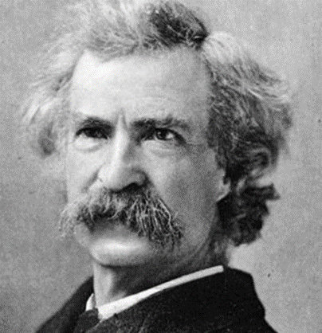
About the title…
‘That’ Mark Twain quote – but how true is it?
Irony – reports of the quote also exaggerated!
Incorrect version from popular historical account
“It is my belief that nearly any invented quotation,
played with confidence, has a good chance to deceive.”
“If you don’t read the newspaper you are ill-informed;
if you do read the newspaper, you are misinformed.”
Capturing the Energy
www.capturing-the-energy.org.uk
Notes:
The original title of this presentation refers to a well-known line that the writer Mark Twain is thought to have said… but ironically, reports of his joke about his death are themselves exaggerated!
The truth is he was simply explaining some confusion caused because his cousin was ill. The misquoted version first appeared in a popular biography of Twain, published after his actual death. Which just shows how it’s possible for the perspective of history to alter the factual record – i.e. historians cannot always be trusted!
And it’s worth noting a couple of interesting quotes by Twain on the theme of truth… how relevant they are, more than a century later! And I should say at this point that the facts and statistics I mention today are not fake – references are available if needed!

Slide 4
UK oil and gas – the current downturn
Over 100,000 jobs lost, 2014-16; 360,000 more hit by 15-20% pay cut
Unemployment up by 33% in 1 year; use of food banks doubled
Companies cutting 15% of staff on average – nearly 1 in 6
Oil price slump – revenue down 30%
Capturing the Energy
www.capturing-the-energy.org.uk
Notes:
Before looking back, I want to present some numbers about the current downturn in oil and gas, and its effects on the UK. It’s been estimated that from late 2014 to summer 2016, over 100,000 people lost their jobs in the oil industry and its supply chain, with 360,000 others taking pay cuts of about 15-20%.
That’s tens of thousands of families, most of them living and working in one part of the country – the North-east of Scotland – losing an income source that was often substantial, and in many cases funded a prosperous lifestyle with big financial commitments.
One official measure of unemployment – the benefit claimant count – showed a rise of more than 33% between December 2015 and December 2016 (the opposite of a national trend), and at the same time, use of charity food banks in Aberdeen doubled.
A recent business survey found that operators had reduced their workforce by 15% in the past year, and expected to cut another 5% in the coming months. Fifteen percent - that’s nearly 1 in every 6 employees.
And it’s no wonder. In 2015, the industry’s revenue fell by 30% as oil prices were halved, making around 40% of North Sea fields unprofitable, and exploration reached its lowest level ever.

Slide 5
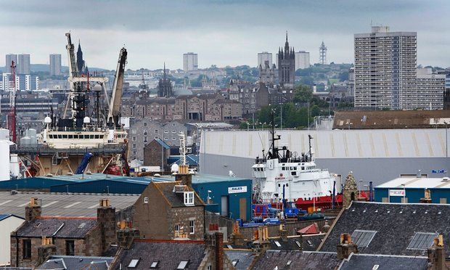
Impact on Aberdeen
A shock for the ‘recession-proof’ city
Before: house prices rocketing; hotels full; shops & restaurants always busy
Now: a very different mood… but not bad news for everyone
“We got a bit obsessed by oil.”
Capturing the Energy
www.capturing-the-energy.org.uk
Notes:
The result has been a 15% decline in Aberdeen’s population since before the current downturn.
For a city that had seen a steady rise in employment, average earnings, house prices (and all the other aspects of an economic boom) since the start of this century – a city that was apparently recession-proof even during the financial crisis that rocked the rest of the country – this has come as quite a shock.
Before the downturn, house prices were rising by as much 17% in a year – faster than London – and the city had more millionaires per person than the capital
Now there are stories of people giving away luxury cars they cannot afford to pay for, restaurants closing as local residents abandon a culture where going out to eat was the ‘default’, taxis left empty where there was high demand before, and hotels struggling to adapt to something like 40% (and not full) occupancy.
At the same time, though, other sectors are now seeing much less staff changes and are more able to compete for new recruits, while hotel vacancies have been good for tourism, as it is now easier for informal visitors to find (and afford) accommodation here. In the words of Steve Harris, the retired Chief Executive of VisitAberdeenshire: “We got a bit obsessed by oil.”

Slide 6
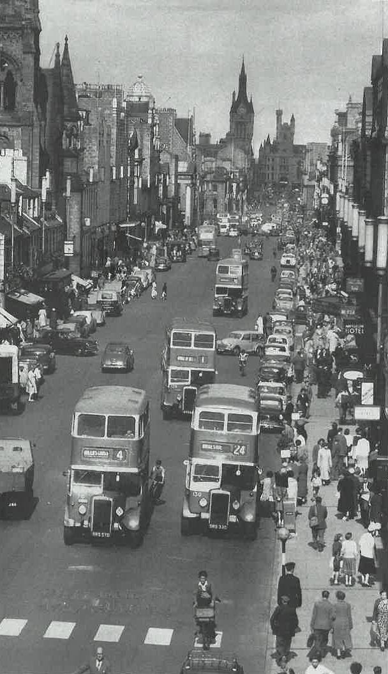
Aberdeen before oil
(Yes, this time did exist!)
1960s: traditional industries on decline;
a city ‘separate’ from the rest of the country
Gaskin report, 1969: ‘ignored’ North Sea potential
1970: Rubislaw closed; Ekofisk announced
Capturing the Energy
www.capturing-the-energy.org.uk
Notes:
But for people like me, the good time was ‘normal’. Born in Aberdeen in the 1980s, it’s almost impossible for me to imagine a time when the city was not “obsessed” by oil. So it’s been fascinating for me to discover stories and photos of a time when the Granite City faced a similar need to change.
By the 1960s, Aberdeen’s traditional industries of fishing and quarrying were on the decline, and although there had been speculation about the prospect of oil under the North Sea, it took the city (and the country) a number of years to realise this massive economic opportunity.
In the meantime, Aberdeen remained isolated – economically, socially and culturally. As well as the regular fish trains to London, people were leaving also, as the young generations’ ambitions outstripped the opportunities available locally. Even travelling to Aberdeen was no easy task. As late as the mid-‘70s it was said that the only stretch of road between Scotland and Turkey that was not dual carriageway was the 60 miles between Aberdeen and Dundee.
In 1964, the Wilson government gave the north-east of Scotland official Government Development Area status to try to help to regenerate its economy… but there was no mention of oil and gas in that strategy. And even the important report by Professor Gaskin on the region’s economic potential mostly ignored the North Sea, despite the visibility of both Shell and BP in the city as well as the many supply and survey boats appearing in the harbour at the time.
Only after 1970 – a year which brought both the closure of the famous Rubislaw granite quarry and the announcement of the discovery of the huge Ekofisk oilfield just over the Norwegian border – did Aberdonians start to notice the arrival of more strangers and more money in the city.
The transformation that has happened in the city since then was surely unthinkable before then – in the same way that people today struggle to see a future for the city after oil. I’ll return to that later.

Slide 7
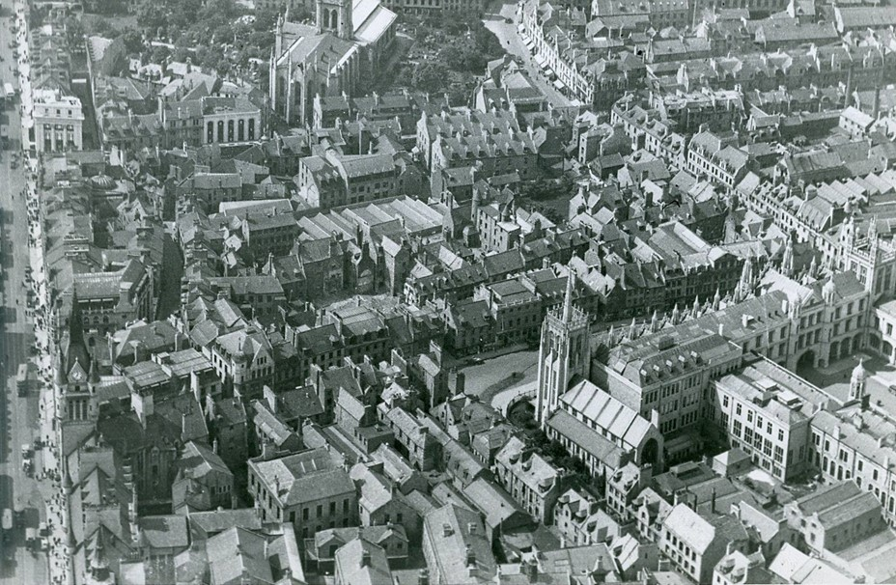
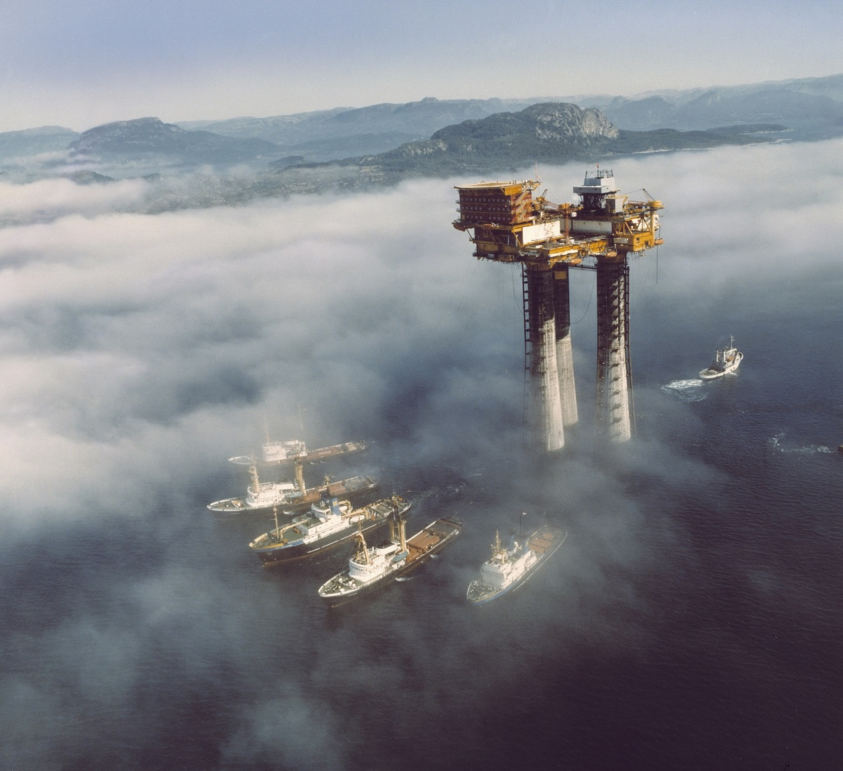
Image courtesy of Aberdeen City and Aberdeenshire Archives
Capturing the Energy
www.capturing-the-energy.org.uk
Image © Shell UK

Slide 8
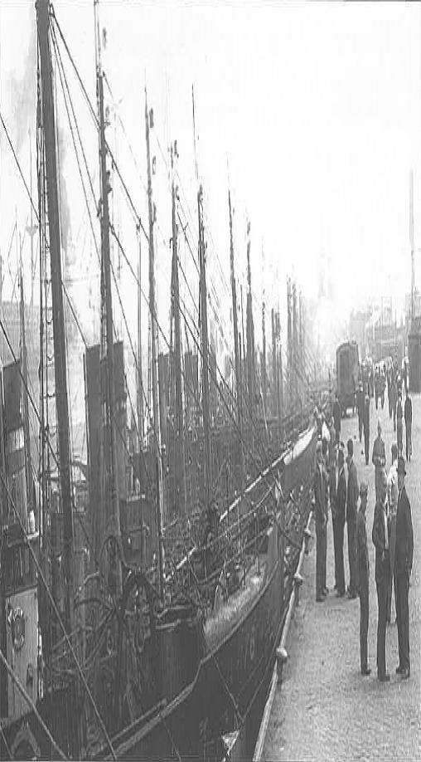
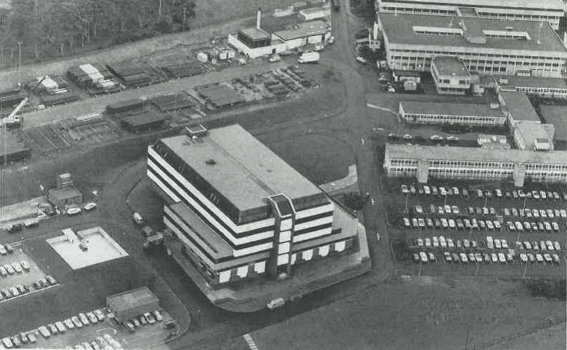
Understated estimates
Arrival of oil not a rapid development
Who were the main pessimists?
What were their motivations?
Business & government in a ‘poker game’
--> uncertainty --> caution --> lack of planning
Capturing the Energy
www.capturing-the-energy.org.uk
Notes:
So while it’s easy to imagine that the arrival of oil was a distinct event, a change that happened very rapidly, in fact it took years of geological surveys, licensing rounds and failed exploration activity before it finally emerged. And even when it did, it wasn’t accepted by everyone, with many politicians and executives quick to declare that any benefits would be short-term.
The conventional wisdom, the common explanation of these attempts to restrict estimates of North Sea oil and gas is that large corporations were afraid to admit how much money could be made because the UK government might exploit the opportunity to raise taxes to improve its dire financial status.
And there is some informal evidence that companies wanted to have some control of the projections by independent analysts of 30-40 billion barrels – which were very different from the 10 billion that was being talked about officially.
In addition, senior figures at both BP and Shell were still showing doubt about the chances of commercial oilfields on the UK Continental Shelf right up to the time of the Forties discovery.
However, the government of the time was also doing all it could to suppress such reports – at least in public. That’s probably because at a time of political and economic turbulence, announcing what seemed like a magical solution would have only increased the pressure on the government to resolve the country’s balance of payments crisis which finally led to the devaluation of sterling in 1967.
In truth, the failure (or refusal) to recognise and make public the scale of the available resources was because of the relationship between government and the industry – public officials made their estimates on the basis of information supplied by oil companies, and the competing interests of the two parties created a stand-off – a high-stakes game of poker.
Whoever was to blame, the result was paralysing. The conflicting reports put doubt in the minds of key stakeholders and possible investors, and there was a cautious approach to establishing a service and supply industry across the country.

Slide 9
Lessons to be learnt
Not first instance of slow response to economic change
Innovation stifled; dearth of major oil entrepreneurs
Parallels – political significance; need for decisive action
Indyref: oil industry high on the political agenda
Now: Wood Review --> Oil & Gas Authority
‘Maximising Economic Recovery’ agenda
Capturing the Energy
www.capturing-the-energy.org.uk
Notes:
This was not the first time that a failure to embrace economic change cost British (and Aberdeen’s) industry. Between the world wars, British shipbuilders produced 40% of the world’s output; this had dropped to less than 10% by the mid-‘60s, partly due to fragmented ownership, poor management, and not enough investment and strategic planning.
And it’s that planning that was arguably lacking in those early days of oil and gas and which might have put the UK – and Scotland in particular – in a stronger economic position today. It’s often said that, with the exception of Sir Ian Wood, the oil industry did not produce any significant entrepreneurs – surprising for when you see how rich and robust it has been.
Might it also be said regarding today that there are vested interests behind the messages from industry and the two governments? The state of the oil industry remains politically as well as economically and socially significant, just as it was for Harold Wilson’s struggling government fifty years ago.
In the campaign for the independence referendum in 2014, it served the pro-Union side well to paint a picture of a declining industry that could not be relied on for long-term prosperity, just as it suited the Yes campaign to proclaim the power of “Scotland’s oil”. Almost every week there was some new analysis of the economic potential of oil and gas which helpfully made the case for one side or the other.
Of course, things have changed since 2014 – last year it was the Scottish Government praising the money it was giving to (quote) “help make a step change to the economy of the North East”, including the City Region Deal between local and national governments that aims to support innovation and diversification.
And that’s where lessons do seem to have been learnt – the industry has recognised the need for radical change and is embracing collaboration and efficiency projects within the overall theme of Maximising Economic Recovery from the North Sea, started by Sir Ian Wood himself and managed by a new regulator, the Oil & Gas Authority.

Slide 10
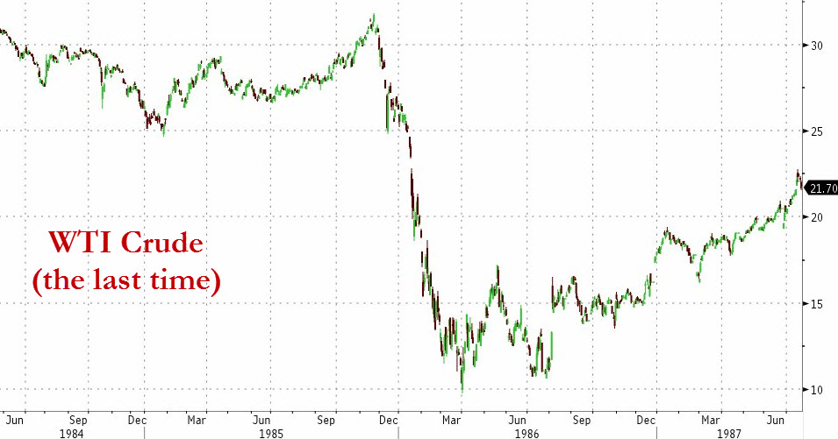
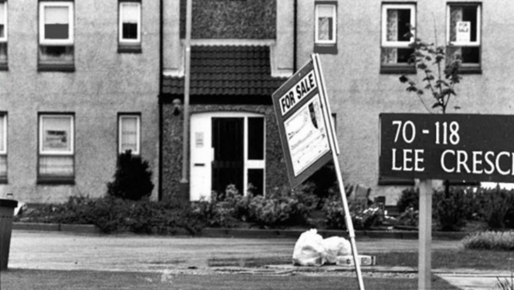
1980s downturn
1986: oil price shock
“Virtual panic” hit Aberdeen
Job cuts and unemployment
Housing market slump
Exodus from the city
Industry response: familiar?
Capturing the Energy
www.capturing-the-energy.org.uk
Notes:
But we have been in this situation before. Aberdeen was also hit hard by the 1986 downturn, which can be viewed differently from a historical perspective – one analyst of that time and observer of today called it a “great cleansing operation” and “therapeutic” (though, he admits, not so much at the time).
But if that is true, maybe it’s because that crisis was fairly short – the result of an oil price shock caused by Saudi Arabia’s decision to increase production as a challenge to other producers.
In response, companies in Aberdeen “battened down the hatches”. Nearly 1 in 4 offshore jobs were lost and thousands of onshore roles were cut. Aberdeen’s property market went into meltdown – For Sale signs went up everywhere and prices dropped by nearly 10% as rising unemployment combined with a rush of housebuilding to create a massive oversupply.
“Virtual panic” led many to abandon their homes and other costly assets. One locally famous illustration of those events was Lee Crescent North, a suburban street whose rapid development was typical of the earlier oil boom but where more than 40 homes were for sale at one point in 1986.
The response from industry was summarised by the head of the leading trade association, who talked of the need for “greater use of new technology, improved project management, and the exploitation of existing spare capacity” in order to find ways of producing oil and gas more cheaply.

Slide 11
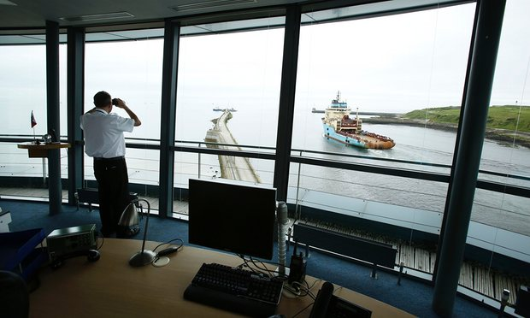
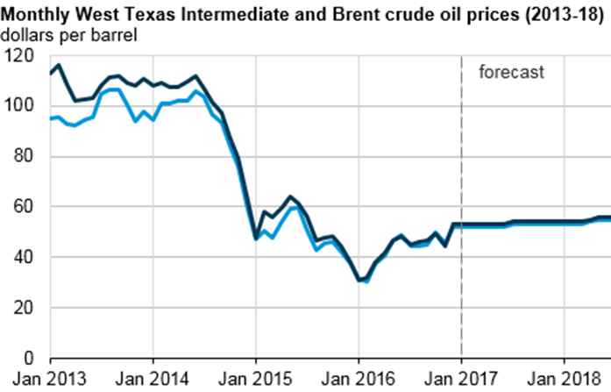
1980s: comparing then and now
Today’s ‘culture change’ rhetoric is not new
1990s CRINE agenda – fizzled out
Now (again) processes under scrutiny
Also differences – structural factors
No longer just about cost-cutting
Oil price unlikely to bounce again
Capturing the Energy
www.capturing-the-energy.org.uk
Notes:
All of which might sound very familiar. Indeed to many, the language being heard at conferences these days is also not that different to the days of CRINE – the 1990s Cost Reduction Initiative for the New Era.
This, also, encouraged the industry to work together to achieve greater efficiency, with shared practices leading to reduced bureaucracy. The objective then, just like today, was to keep mature fields producing, and make smaller discoveries economically viable.
When put like that, the parallels between the present day and the situation 30 years ago are striking. The industry is again being forced to take a long, hard look at how it operates. Rapidly rising costs are being controlled, procedures are being made simpler, more effort is being put into collaboration and innovation, and decision-makers are planning for the long term.
But there are also significant differences. Declining global demand was a factor back then, but that trend was in turn a particular legacy of economic crises a few years before. By contrast, this time, although the same market forces have played a role, other causes are more structural, for example the shift to cleaner energy across the developed world.
CRINE also lacked the authority to force change on the people that had benefited from what had gone before, or to enjoy anything more than weak support from those who might do well in the future. So when oil prices went up again, many reverted to their old ways. What resulted were the very same conditions that had prompted CRINE in the first place.

Slide 12
Aberdeen after oil?
Wood: “back to really busy” by 2020
Estimates shaped by events and prices
How will historians see this decade?
Dawn of decommissioning
Investment and innovation
From offshore oil to offshore wind… not yet
Capturing the Energy
www.capturing-the-energy.org.uk
Notes:
Will Aberdeen emerge mostly unchanged after this difficult period and revert to how things were, or will it take another transformation for the city to survive?
“By 2020,” according to Sir Ian Wood, “we’ll be back to really busy.” He’s estimated that another 15-16 billion barrels of oil are still out there – one third of what has been produced over the past 40 years. It’s a positive message from a man who knows what he’s talking about, but one that contrasts with the 30-40 years of production predicted just 18 months earlier.
The difference shows how such predictions can be meaningless – that bold optimism was based on an oil price of well over $100 a barrel, when just about any pocket of hydrocarbon is potentially profitable, whereas Wood’s forecast was made to respond to the perception that North Sea oil is drying up.
This downturn may be looked back on as the dawn of decommissioning – a signal that the UK Continental Shelf is entering a more mature, ‘late life’ phase. Some have seen this coming, predicting at least as far back as 2011 that production had reached its peak.
However, just as some reflect philosophically on the events of the ‘80s, industrial historians may in future describe this era as “a difficult period but with a good outcome.” From their perspective this decade will be seen above all as a time of great change in strategy, regulation and investment.
The fact that only a small number of homes on Lee Crescent North have been available at any time during this downturn, and that house prices have only dropped slightly despite a sharp decline in sales, is a sign that the city is more resilient this time.
More than that, Aberdeen is in the middle of one of the biggest periods of infrastructure investment in its history, with long-awaited projects like the bypass and other major road network improvements, airport expansion, a new exhibition centre, Art Gallery and Music Hall renovation, and retail developments – including the controversial Marischal Square complex
In all sectors – from hospitality to technology – businesses are having to work harder to sell their products and services, but maybe only as much as similar companies in the rest of the UK have needed to since the 2008 recession or the 2010 election.
I’ve spoken to many people in their 20s and 30s working for small businesses in Aberdeen who say their knack for innovation and entrepreneurship is more in demand now than ever before. Others say the growing reputation and regeneration of nearby Dundee shows that ‘black gold’ isn’t all that matters.
Also, knowledge gained in one field of engineering can easily be transferred to others. A prominent example is the European Offshore Wind Deployment Centre – an innovative £300m 11-turbine windfarm being built in Aberdeen Bay and expected to start producing next summer, generating up to 70% of Aberdeen's domestic electricity demand.
That’s good news for Scotland’s economy, and for the environment… although the windfarm has some high-profile opponents! But with projects in areas like tidal energy, and carbon capture and storage, struggling to make a profit or even get funding, we’re not yet at a point where renewables are a replacement for fossil fuels, either for energy production or employment.

Slide 13
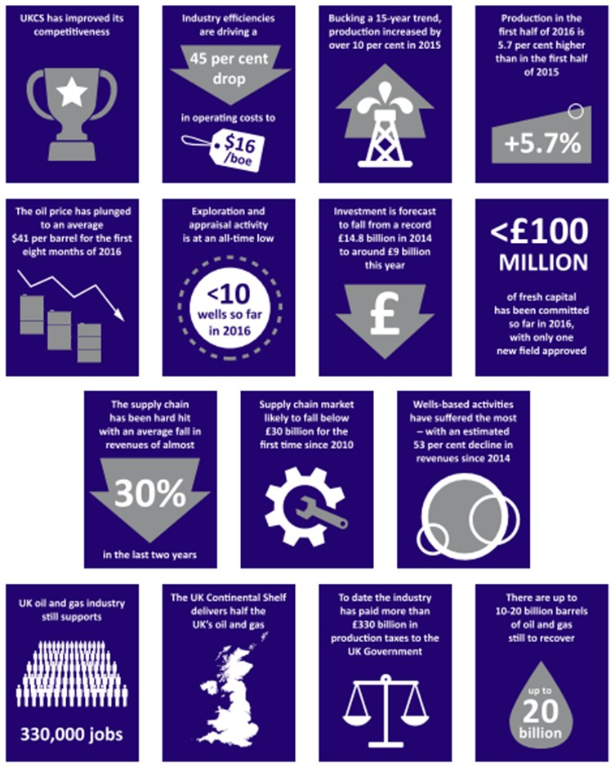
Oil 2.0
Oil can survive but this depends on:
Turning talk about action
Developing new technology
Creating a stable tax regime
Another referendum? Who can we trust?
Transformation then, evolution now
Challenge conventional wisdom
Capturing the Energy
www.capturing-the-energy.org.uk
Notes:
So it’s a relief that oil and gas in Aberdeen does still have a future, even if it looks and feels different to how it was before. Oil & Gas UK’s 2016 Economic Report states that the oil price has stabilised at around $40 a barrel, that the industry still employs or supports a third of a million jobs, and that the cost of production has shrunk to $16 per barrel.
Whether that trend continues and delivers the needed recovery depends on a number of factors –
whether the regular talk in the industry about collaboration and efficiency is made into real, lasting, sustainable actions,
whether technology is developed that allows smaller and isolated reserves to be recovered, before operators rush into decommissioning, and
whether governments can create a stable regulatory regime – and resist the urge to make politically-motivated statements.
On that last point, we have the prospect of another independence referendum – this is intriguing when you consider the changes in the industry and the Brexit vote, but also the way that last year’s shock results suggest a loss of trust in ‘the establishment’ and the declining power of persuasion of ‘experts’.
Just imagine if that type of atmosphere existed in those exciting early days of North Sea oil – the task of those with the facts trying to convince industry, the Cabinet and the public about possible reserves would have been even harder, and criticism about the lack of a strategy might have been even more relevant.
Whatever the early failures, though, the UK offshore oil and gas industry has delivered huge economic benefit to Aberdeen and beyond. To reflect on what the city was like before the North Sea Klondike is to realise what an extraordinary transformation has occurred and what an amazing 50 years it has been.
It also puts in context the evolution – not revolution – that is required for the city to thrive in an era where oil cannot now be relied on. That, in itself, is one of the key lessons from history – that oil is a volatile commodity, which brings bust as well as boom, and that no price bubble ever lasts for too long.
We might also conclude that ‘conventional wisdom’ is not to be trusted – not in the ‘60s and ‘70s, and especially not now amid major constitutional change.

Slide 14
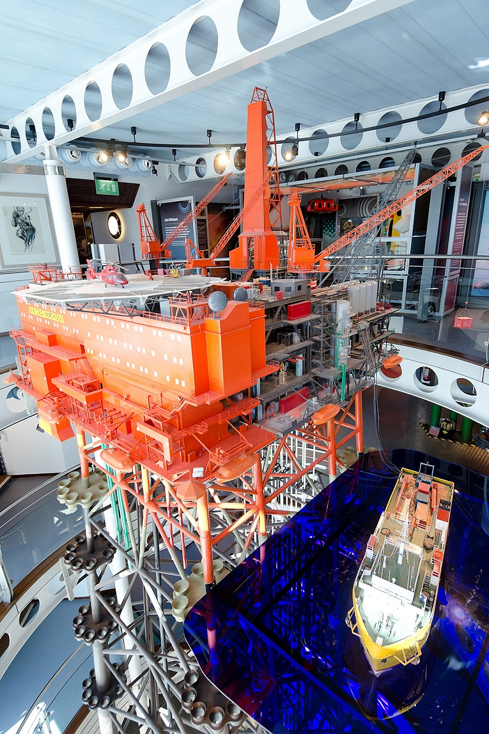
Capturing the Energy
Learn from the past to inform the future
Documenting the industry’s achievements
Increasing awareness of its importance
Assessing its economic and social impact
Oil & Gas UK support; Steering Group oversight
2017: Murchison collection; OGA IM Strategy;
conferences; mobile app; Age of Oil exhibition
Capturing the Energy
www.capturing-the-energy.org.uk
Notes:
One of the ways we can help to protect the future of the UK oil and gas industry is to preserve its past – and that’s what Capturing the Energy aims to do.
A major development this year will be the addition of a brand new collection relating to the Murchison field - well-known because there’s a model of the platform in the Aberdeen Maritime Museum overlooking the harbour. The field itself has been operated by 4 different companies in its 40-year lifespan and is now being decommissioned by its present owner, CNR.
As well as transferring records to the University’s archive, though, the project also seeks to work with the industry on some information management and public relations initiatives. The Oil & Gas Authority has created an IM Strategy and Delivery Programme, and Oil & Gas UK has various projects ongoing too. The current situation in the industry offers challenges for us but also opportunities because of the need and desire for reform; I believe the culture of efficiency and collaboration is here to stay this time.
Other exciting plans for 2017 include a mobile app that will be an interactive showcase of stories from the archives, to be available in time for the Offshore Europe conference in Aberdeen in September, and an exhibition called 'Age of Oil' by renowned visual artist Sue Jane Taylor at the National Museum of Scotland in Edinburgh from July; parts of which will then go on display at the University of Aberdeen early next year.

Slide 15
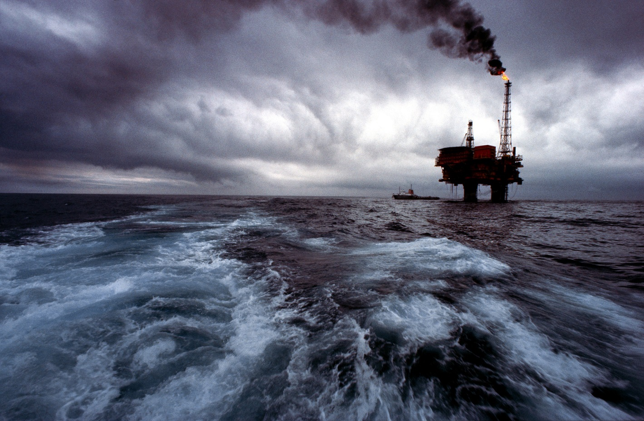
Image © Shell UK
Thank you. Questions?
Email: joe.chapman@abdn.ac.uk
Phone: 01224 272545
Find me on LinkedIn and Twitter (@joechapman30)

